Slide 1
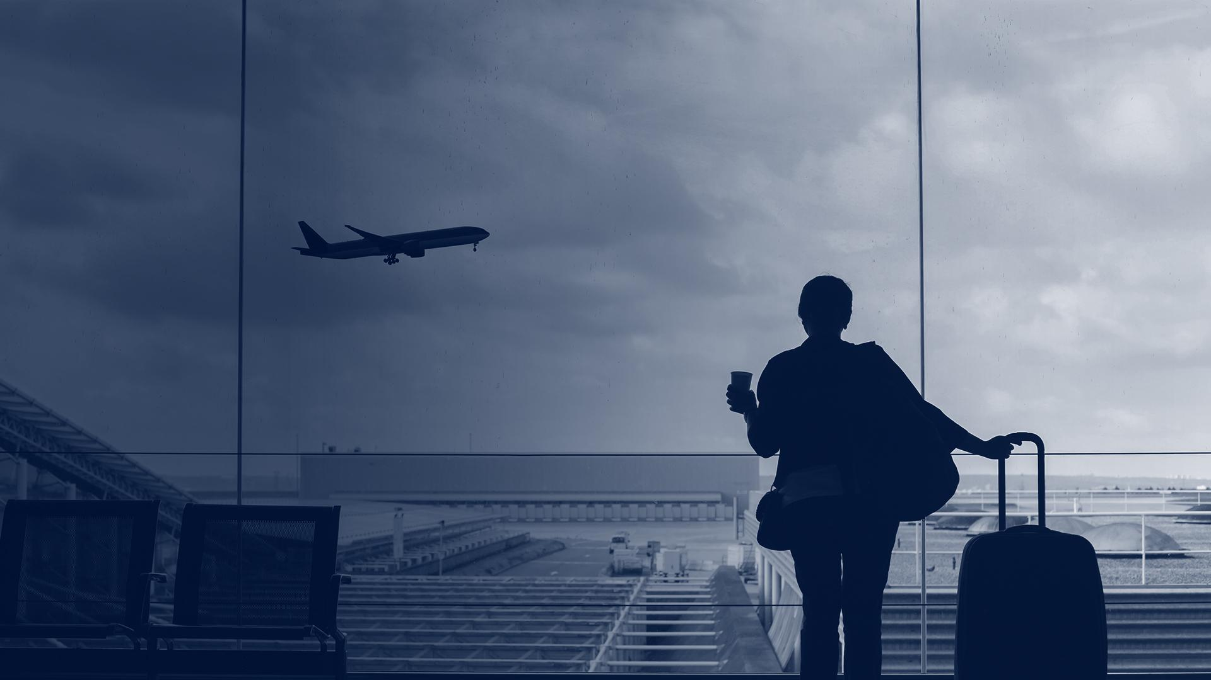
Sample Travel Briefing:
Research Security
SECURE Northeast Regional Center
Last updated: 8/24/2025

Slide 2
A Note to Users: Please read before using
The briefing provides a structured curriculum for RSOs to review with travelers prior to departure.
RSOs should customize the briefing based on specific institutional policies and procedures.
The following slides are especially important to customize to institutional requirements:
  Slide 5: Travel Registration
  Slide 6: Loaner Laptop Program
  Slide 15: Disclosure Requirements
  Slide 17: Contact Information
Follow instructions in these yellow boxes to customize the content to your institution's requirements

Slide 3
What is Research Security?
“Safeguarding the research enterprise against the misappropriation of research and development to the detriment of national or economic security, related violations of research integrity and foreign government interference.”
NSF Office of the Chief of Research Security Strategy & Policy

Slide 4

Types of Research Security Issues
Theft of data, IP, publications
Manipulation of data
More obvious
Malign Intent to
Impact Research
Intention to slow down, reshape or halt certain lines of scientific or academic inquiry
Transnational repression
Attempting to quash certain lines of research or shape the topic
Less obvious

Slide 5

Register Your Travel
Insert institutional policies and procedures for travel registration on this slide
Delete this box
Policies and procedures for travel registration:
Requirements for uploading travel itinerary and housing accommodations
Describe what resources global safety office/travel team provides for travelers: pre-travel information, factsheets and alerts, financial, cultural, and social norms for your destination.
Describe where travelers can find requirements and travel support resources (emergency contact). Include website link.
Consider adding screenshots of travel registry interface
Delete this box

Slide 6
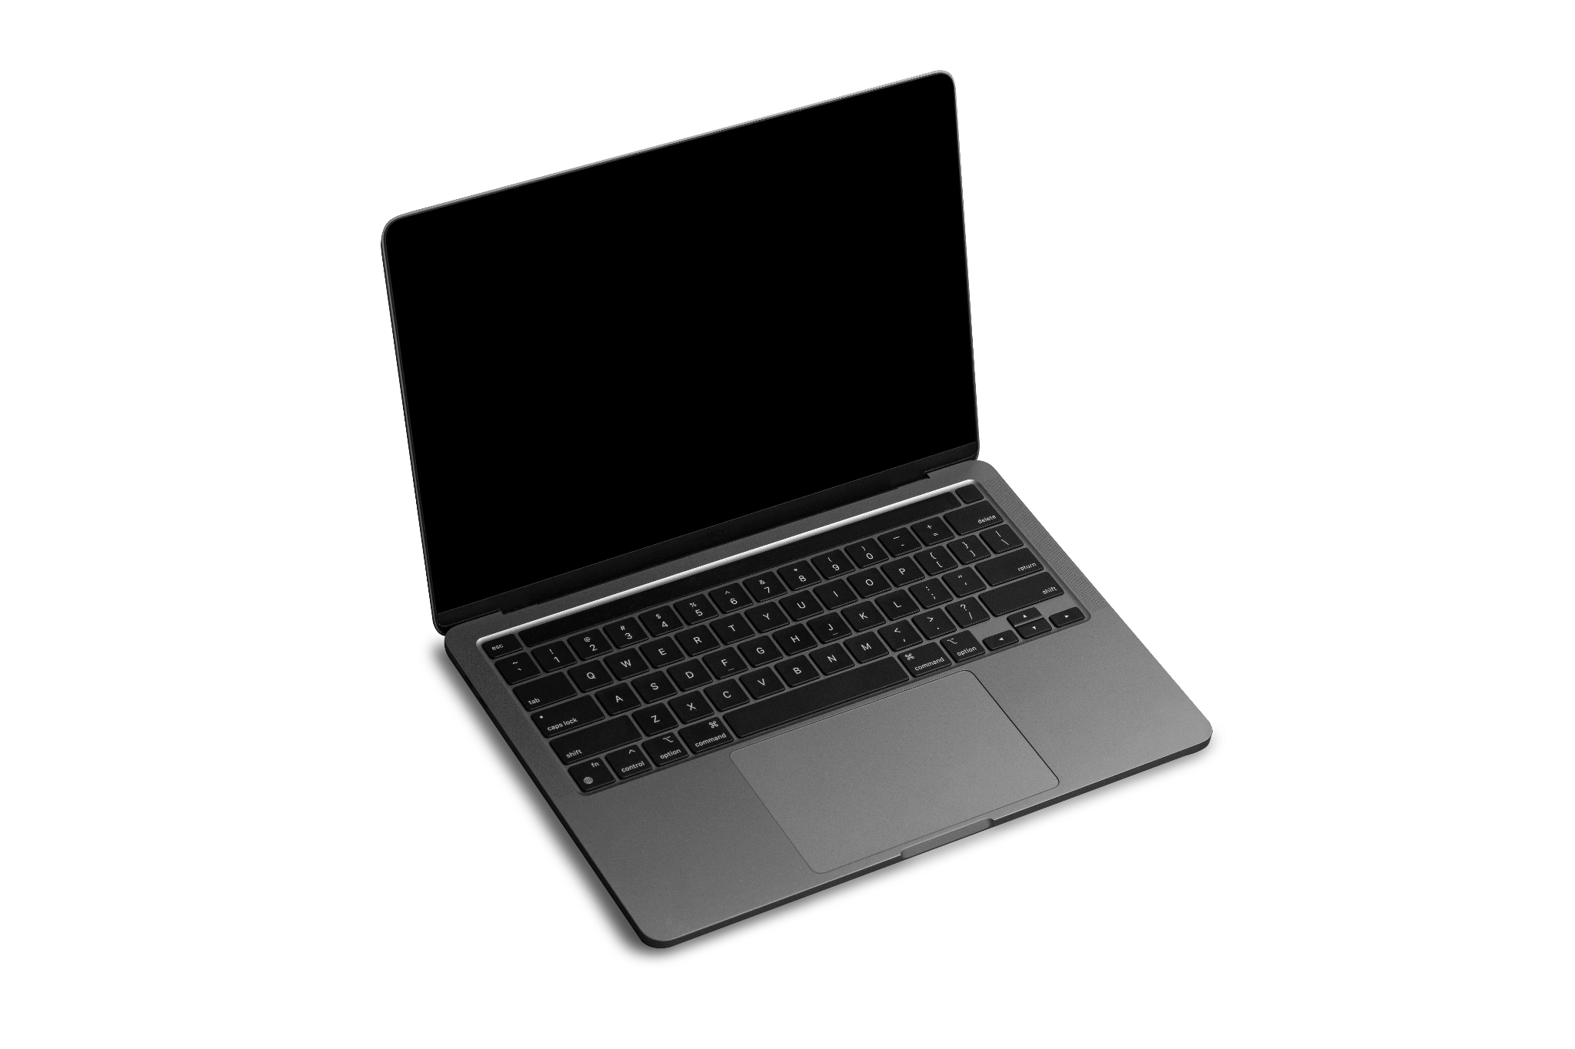
Loaner Laptop Program
How to request a loaner device
Where to pick up/return device
What countries are loaner devices required for
IT support contact information
Additional resources/guidance documents on installing/using VPN, 2FA, accessing cloud storage
Insert institutional policies and procedures related to loaner device programs on this slide
Delete this box

Slide 7



How to clean devices
Follow these steps for institutional/personal devices you are taking with you:
Set up your laptop:
Remove any research data and IP (e.g., export controlled, sensitive data) from local hard drive and store them in
institutional cloud storage
Use encryption* to protect your files
Install institutional VPN* software
Back up your data on an institutional cloud environment and/or external hard drive; leave the backup at home
Consider wiping devices to reduce compromise risk
Install the latest software and security updates on all devices because outdated software increases security risks
Forget all saved Wifi networks and Bluetooth devices
Set up your mobile devices:
Turn on security/PIN codes (6+ characters) for your device’s lock screen
Install end-to-end encrypted messaging applications* (e.g., Signal, WhatsApp)
Uninstall nonessential applications (e.g., social media)
*Encryption and VPN are illegal and/or unavailable in some countries

Slide 8
What are elicitation attempts?
Elicitation (or foreign information collection) is used by various actors, including intelligence agencies, to manipulate people into revealing information that is not readily available or publicly known, such as trade secrets, personal information, or details about a person's work (i.e., research IP).
Pay attention to elicitation techniques:
Subtle questioning
Professional requests
Exploiting expertise
Flattery
Additional resources: FBI Elicitation Guide
DCSA Elicitation Guide

Slide 9
Recognizing and Countering Elicitation
Be cautious when discussing your research during your travel!
Be aware of the techniques used in elicitation attempts:
  Desire to help/appear knowledgeable
  Leading questions
  Building rapport
Be cautious of people who are overly eager (e.g., probing for specifics), especially about sensitive and/or unpublished information
Be aware of your own tendencies to want to be helpful, polite, or appear knowledgeable
Do not enter any agreements/collaborations (verbal or written) with any individuals/entities/institutions

Slide 10
Cybersecurity Guidelines for International Travel
Don’t leave your laptop unattended (locking in a hotel safe/room is ok in most destinations)
Consider using privacy screens to prevent shoulder surfing.
Don’t use public USB power stations (i.e., airport, hotel room)
Don’t allow others to plug devices, such as USB sticks, into your devices
Don't auto-connect to networks and avoid using public wifi
Follow institutional VPN requirements
Follow institutional guidelines for accessing data via cloud storage environments
For mobile devices:
  Turn off “join wireless networks automatically”
  Always manually select the specific network you want to join
  Turn off wireless and Bluetooth when not using these features (Airplane mode does not always disable Bluetooth)
  Disable location services when not needed

Slide 11



Foreign Talent Recruitment Programs (FTRPs)
Not all FTRP are illegal or problematic
FTRP defined as “Malign” are prohibited per the CHIPS & Science Act of 2022
Traits of a Malign FTRP:
Sponsored by a foreign country of concern
Compensation or remuneration
Problematic obligations or activities

Slide 12




Working During International Travel
You are allowed to:
Do not:
Download any documents/files to your devices
Access your email to work
Connect to university/
institutional VPN

Slide 13
Export Controls
Everything you take or ship out of the US is considered an export, including:
  Devices/tangible items
  Software
  Data
  Research equipment/samples
Everything you carry into the US is considered an import
Imports & exports may require an export license
Deemed exports occur when you share export controlled technology, information or source code to a foreign national within the U.S.
!
Ensure that the devices, presentations, and/or research material you bring with you:
Do not contain any export-controlled data or technology, or
You have the proper export control licenses

Slide 14
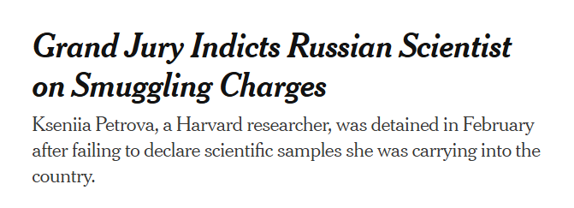
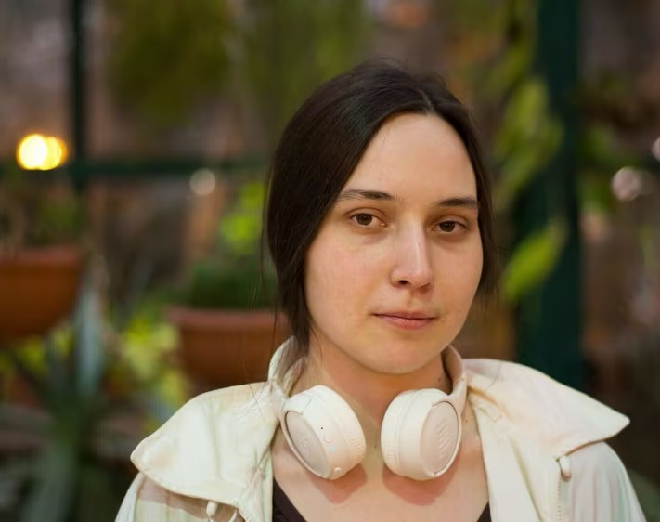
Case Study
Russian-born researcher Kseniia Petrova was returning from France where she collected frog embryo samples for her lab.
U.S. Customs at Boston Logan Airport detained her after discovering the undeclared biological materials in her luggage.
Notes:
Why is this important? Petrova claimed that she didn’t know she was required to declare the samples. She was on personal travel to France when she picked up the samples.

Slide 15
COI Disclosure Requirements
If any part of your trip is being paid for by a third party, it must be disclosed to your institution
Airfare
Hotel
Food
Stipends
Gifts, including things like honorary appointments
Honoraria
Institutional disclosure requirements
Include instructions on how to disclose/institutional processes
on this slide
Delete this box

Slide 16
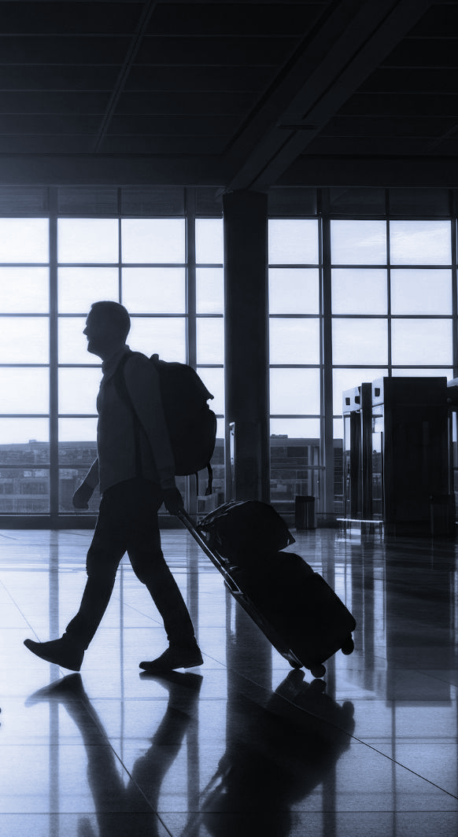
Key Takeaways
When transiting any border, border agents may request to:
  View your devices’ messages, social media, photos, browsing history, and applications
  Separate you from your device(s)
Be aware that the government in some high-cyber risk countries control the internet (i.e., Russia, Saudi Arabia) and may attempt to remotely access your laptop to steal your IP or data.
Even if you are not traveling to a country deemed high-risk, be aware that elicitation attempts are also common in third countries and situational awareness is always important.
Remove all research data and intellectual property that has not been published from your hard drive and store in a university cloud environment

Slide 17
Contact Information
Name of the contact person/department:
Email:
Phone:
Website:
Links to knowledge base articles
Include institutional contact information for research compliance office, IT support and/or travel office, specifying when to contact each office (e.g., IT for system issues)
Delete this box

